Slide 1
Session 2 – Abstraction and Testing Data Skills for Research Kellogg Research Support
August 14, 2023

Slide 2
Three Lessons
Declarative > Procedural
Modular > Monolithic
Automatic > Manual
Notes:
All these things turn procedural unspoken knowledge into explicit, declarative and executable specifications

Slide 3
Roadmap
Declarative Practices
Use code, not your mouse
Source control
Environments
Modules
Structure code into functions
Group functions into files
Unit tests
Command Line Interfaces
Notes:
All these things turn procedural unspoken knowledge into explicit, declarative and executable specifications

Slide 4
1. Declarative Practices
Declarative > Procedural
Modular > Monolithic
Automatic > Manual
Notes:
All these things turn procedural unspoken knowledge into explicit, declarative and executable specifications

Slide 5
2. Modularity
Declarative > Procedural
Modular > Monolithic
Automatic > Manual
Notes:
All these things turn procedural unspoken knowledge into explicit, declarative and executable specifications

Slide 6
3. Automation
Declarative > Procedural
Modular > Monolithic
Automatic > Manual
Notes:
All these things turn procedural unspoken knowledge into explicit, declarative and executable specifications

Slide 7
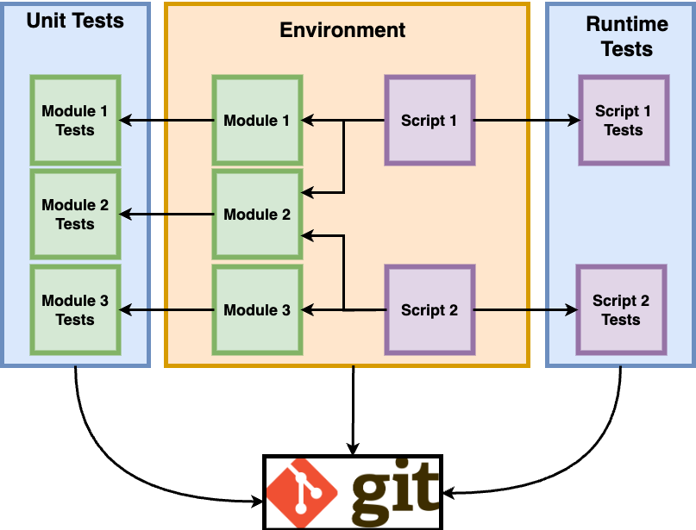
Big Picture
Version Control

Slide 8

Code Modules and Abstractions
Modularity: breaking code down into manageable, configurable, and maintainable chunks
Abstraction: modules that model aspects of the problem semantically, allowing compositional construction of larger systems.

Slide 9


Prime Directive of Modules
DON’T REPEAT YOURSELF
Reduces Errors
Make Code Easier to Modify (single source of truth)
Improve readability
Makes useful code re-usable for multiple programs

Slide 10
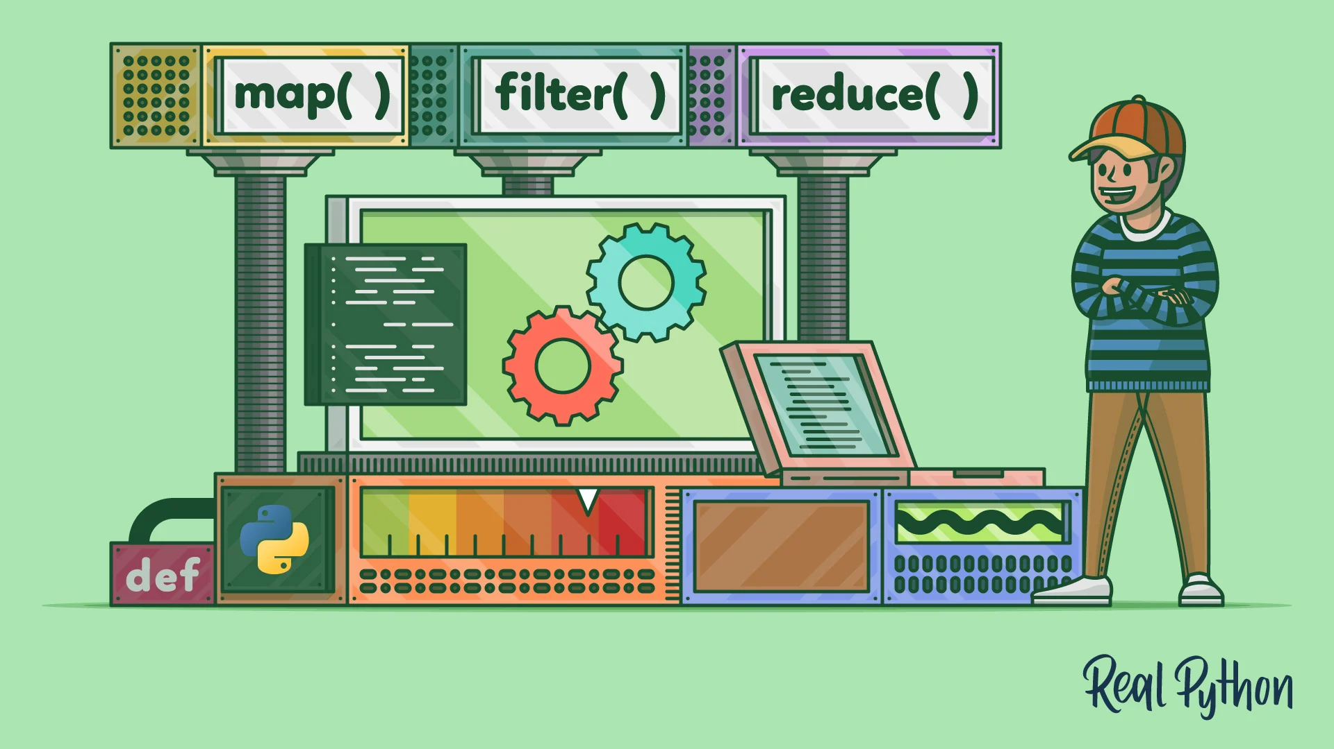
Use Existing (High Quality) Libraries

Slide 11
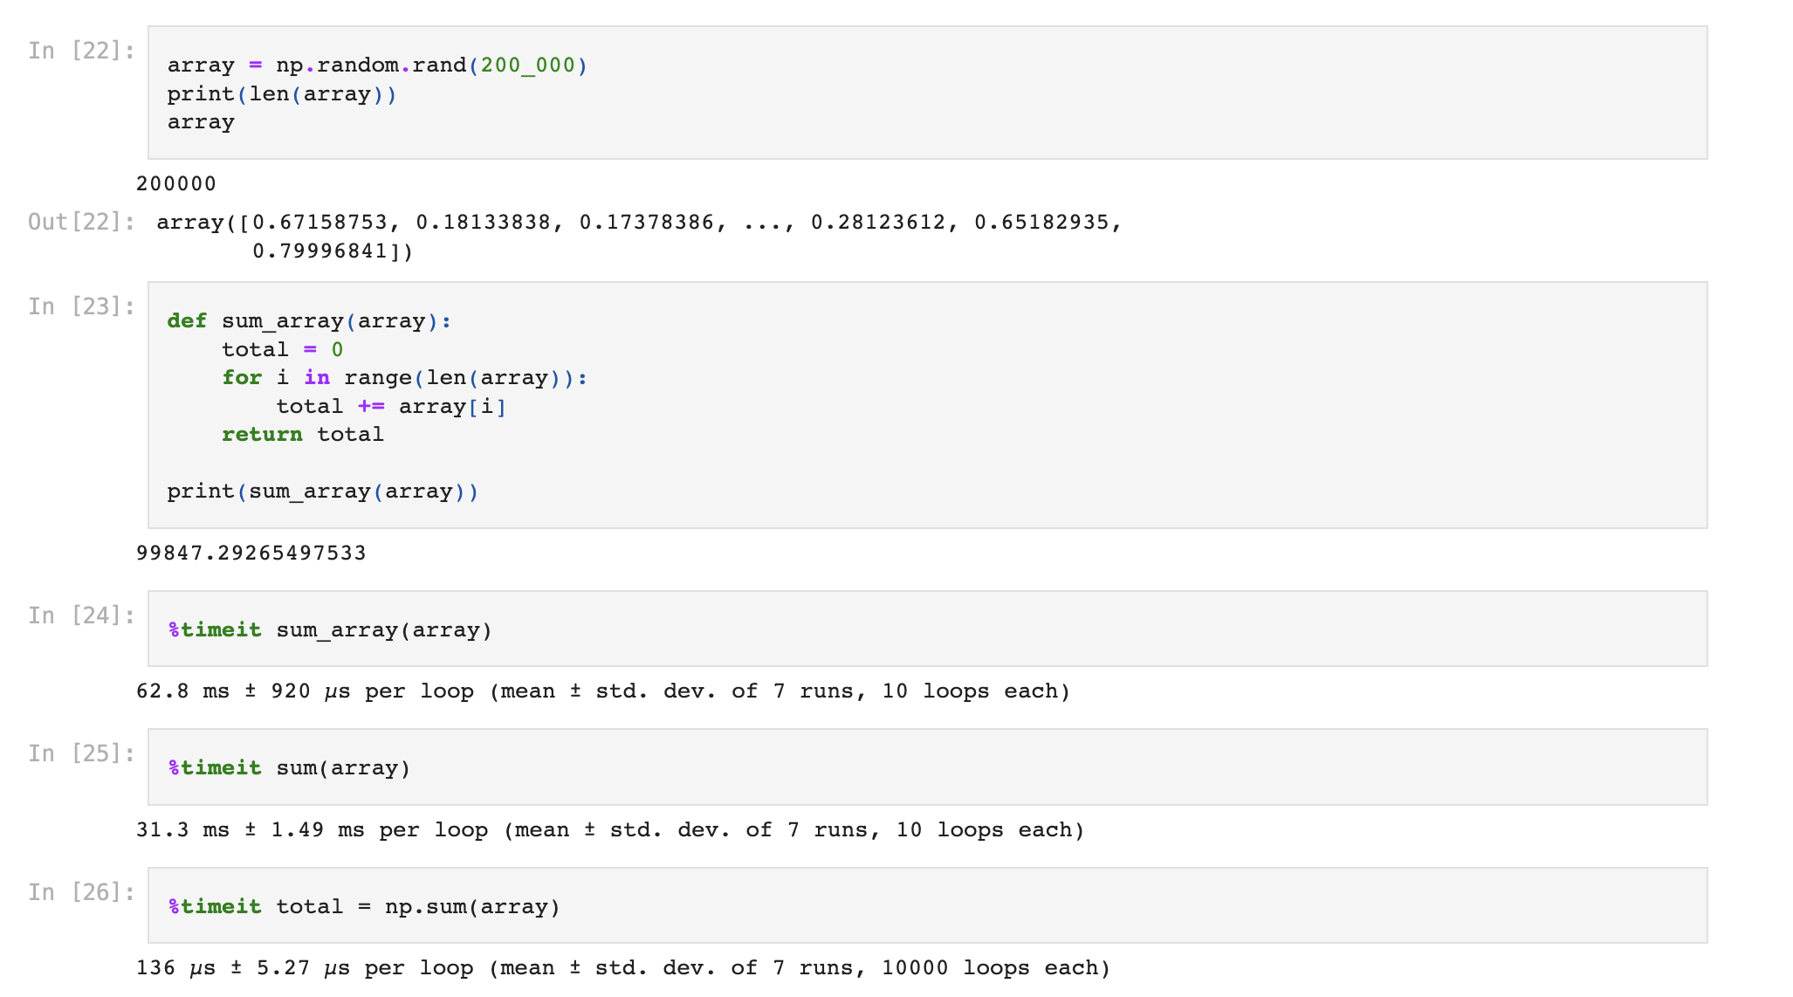
Example: numpy vs. user code (good stata/python/R would be regression)

Slide 12
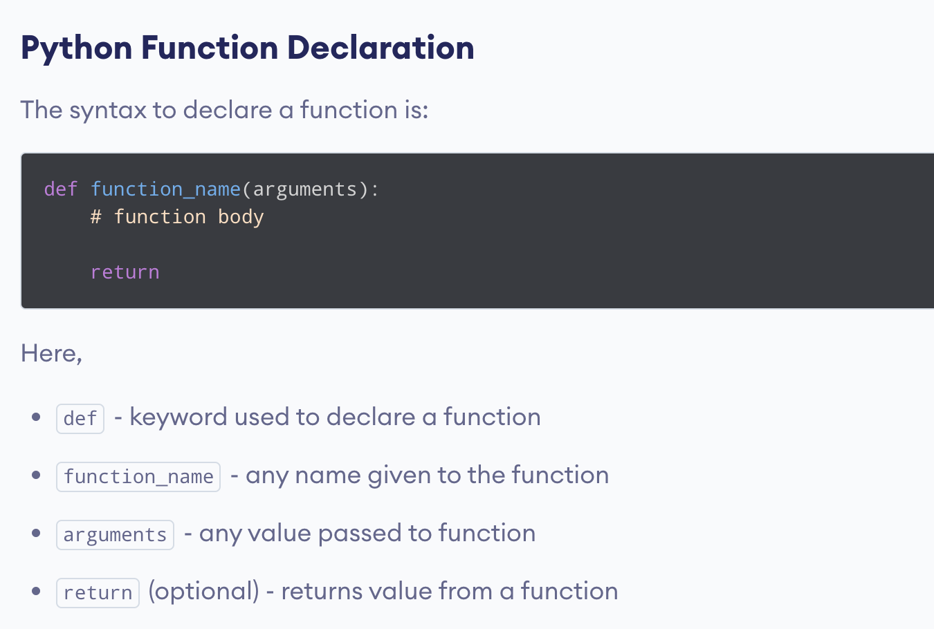
User Defined Functions (python, R, stata)

Slide 13
Functions: Guidance
Don't make a function if code is a one-liner
Use list comprehension
Use Assertion statements
Do only one thing – keep it simple.

Slide 14
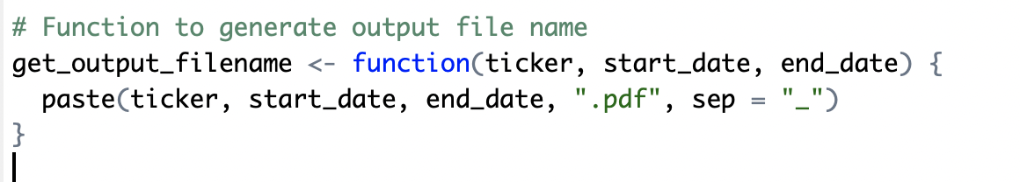
Don't make Functions too simple

Slide 15
Functions: Guidance (change order)
Don't make a function if code is a one-liner
Example: use list comprehension
Use Assertion statements
Do only one thing – keep it simple.

Slide 16
Coding Each Year Separately
// Load the "nlswork" dataset (if not already loaded)
use https://www.stata-press.com/data/r17/nlswork.dta
// Subset the dataset for the year 1976
keep if year == 76
// Run fixed effects regression for the year 1976
xtreg wage, fe
estout, title("Fixed Effects Reg by Year 1976") cells(b(star fmt(%9.3f)) se(fmt(%9.3f))) replace
// Subset the dataset for the year 1978
use https://www.stata-press.com/data/r17/nlswork.dta, clear
keep if year == 78
// Run fixed effects regression for the year 1978
xtreg wage, fe
estout, title("Fixed Effects Reg by Year 1978") cells(b(star fmt(%9.3f)) se(fmt(%9.3f))) replace

Slide 17
Functions with List Comprehension
// function to process any input year
capture program drop reg_by_year
program define reg_by_year
syntax varlist [if] [in], YEAR(string) [Other Options]
// Get the year from the command-line argument
local year "`1'"
// Subset the dataset by the specified year
qui keep if year == `year'
// Run fixed effects regression
xtreg `varlist', fe `Other Options'
// Generate the table title
local table_title "Fixed Effects Reg by Year `year'"
// Save regression results as a formatted table
estout, title("`table_title'") cells(b(star fmt(%9.3f)) se(fmt(%9.3f))) replace
end

Slide 18
Functions: Guidance
Don't make a function if code is a one-liner
Use list comprehension
Use Assertion statements
Do only one thing – keep it simple.

Slide 19
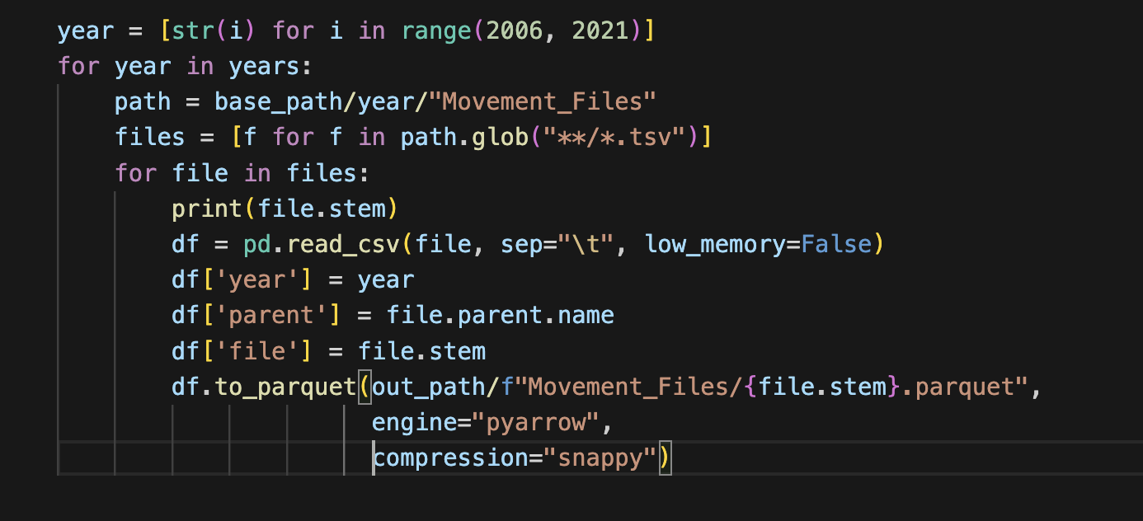
Looping Over Directories

Slide 20
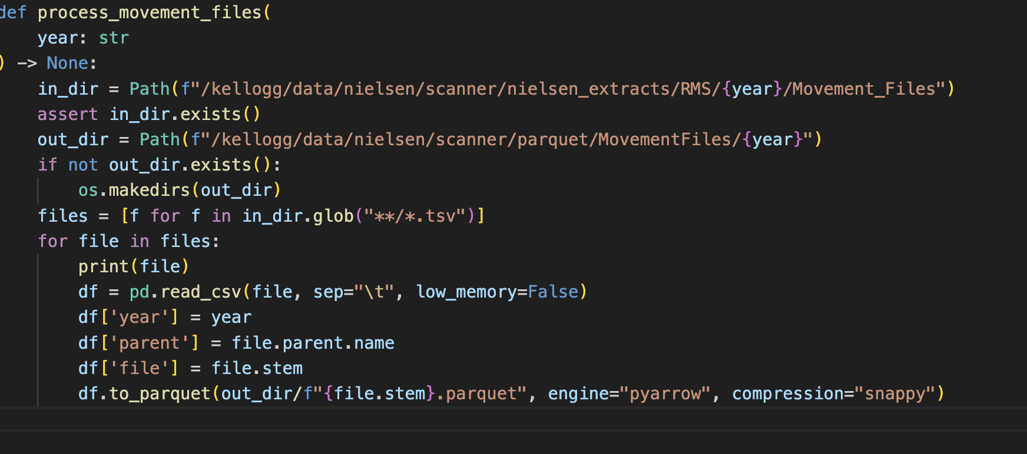
Function: Assertions (abstract details)

Slide 21
Functions: Guidance
Don't make a function if code is a one-liner
Use list comprehension
Use Assertion statements
Do only one thing – keep it simple.

Slide 22
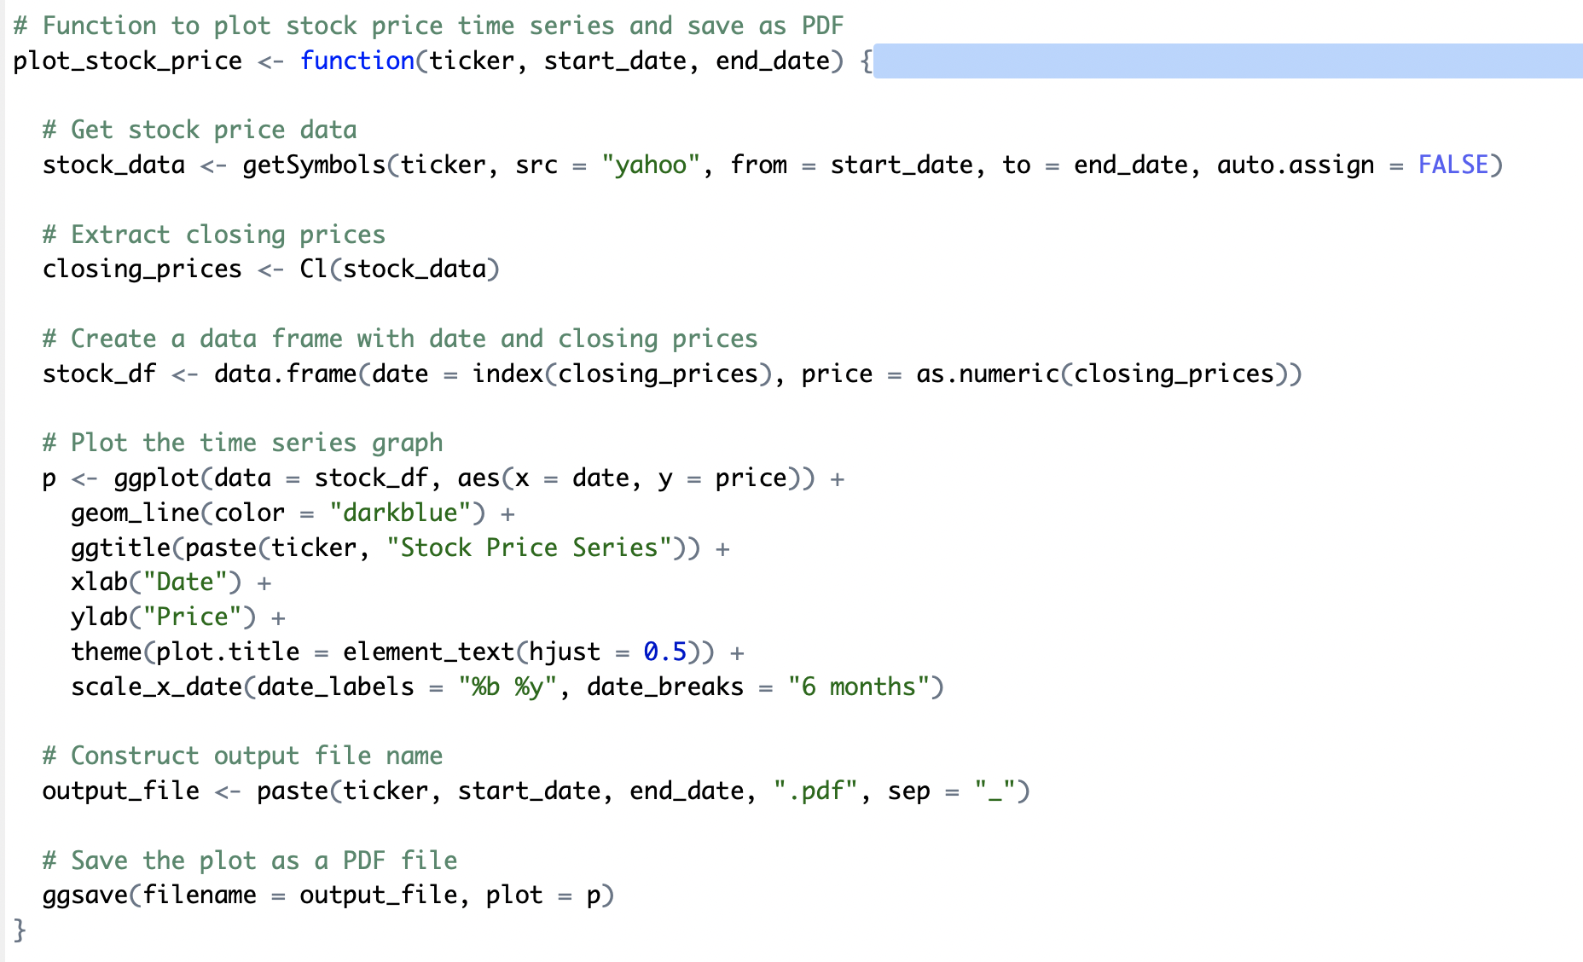
Function with Multiple Steps

Slide 23
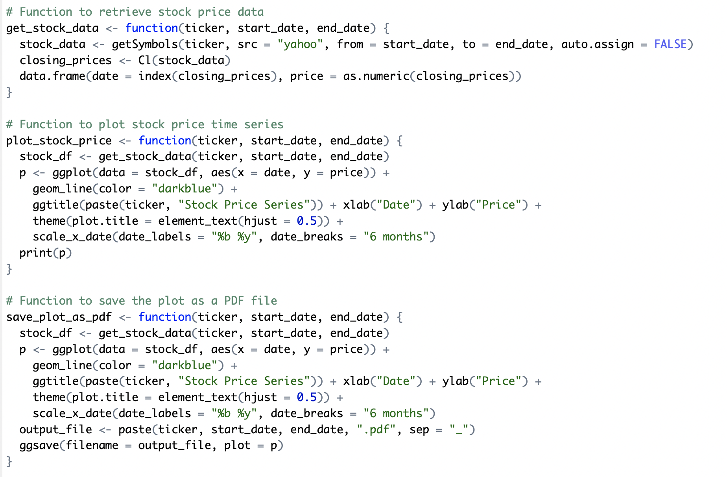
Modular Functions

Slide 24
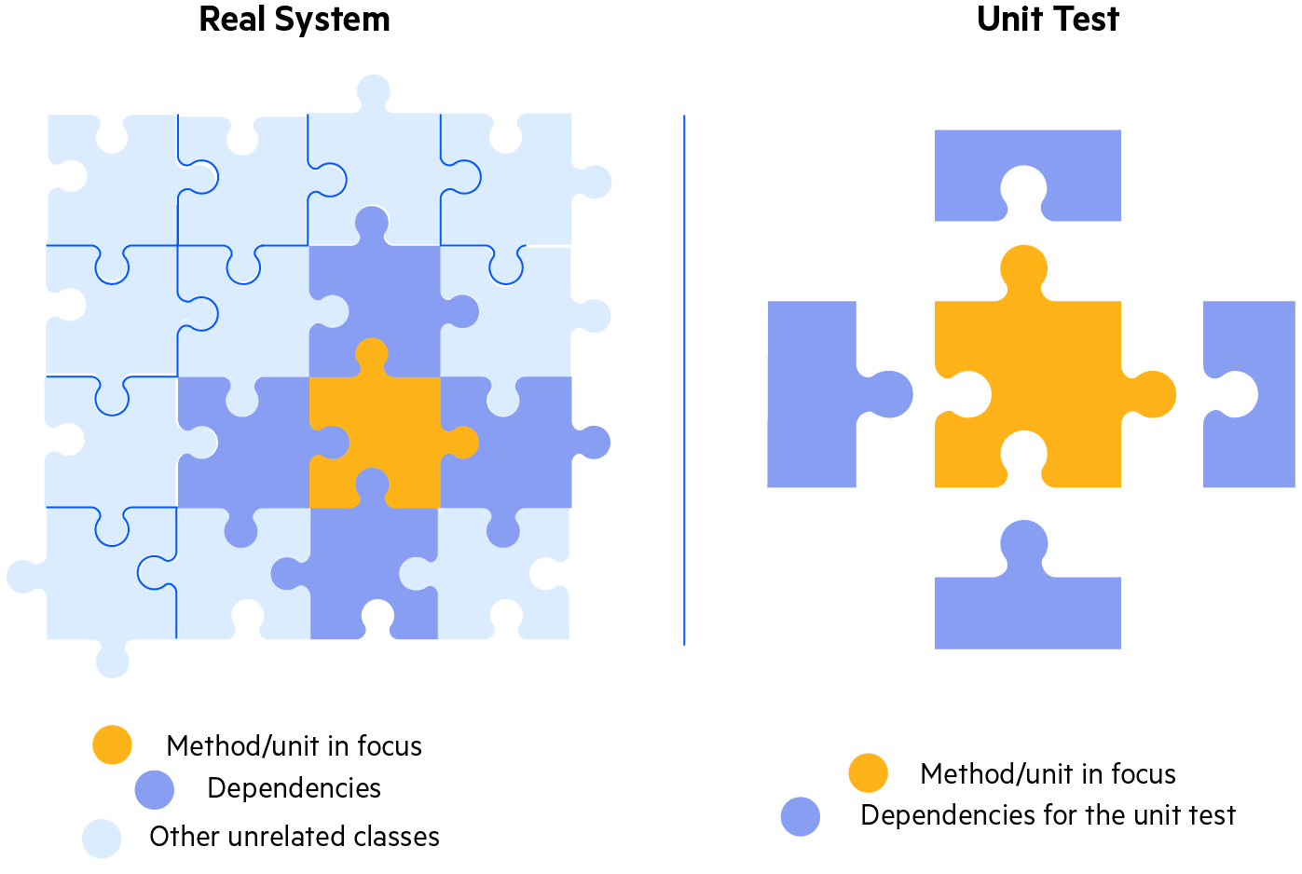
Writing Tests
Unit Tests :
The goal of unit testing is to test a single “unit” of the code in isolation.
For instance, execute a single function with a range of inputs and validate the corresponding outputs

Slide 25
Unit Tests
Proper unit testing is automatic, not manual
Each unit test has three parts:
setup input
activate code, and
assert result
Best to write code and tests at the same time!
Assertions around testing… does this file exist.

Slide 26
Testing a Function (unit test the R functions)
Good test: does directory/file exist already?
Inspecting content of file
Unit tests for the function that processes files in a given directory/year
Demonstrate utility of assertions/exceptions over silently failing
Making assumptions explicit:
Good -- Comment the assumptions for a functions
Better -- Use assert statements to test for your assumptions

Slide 27
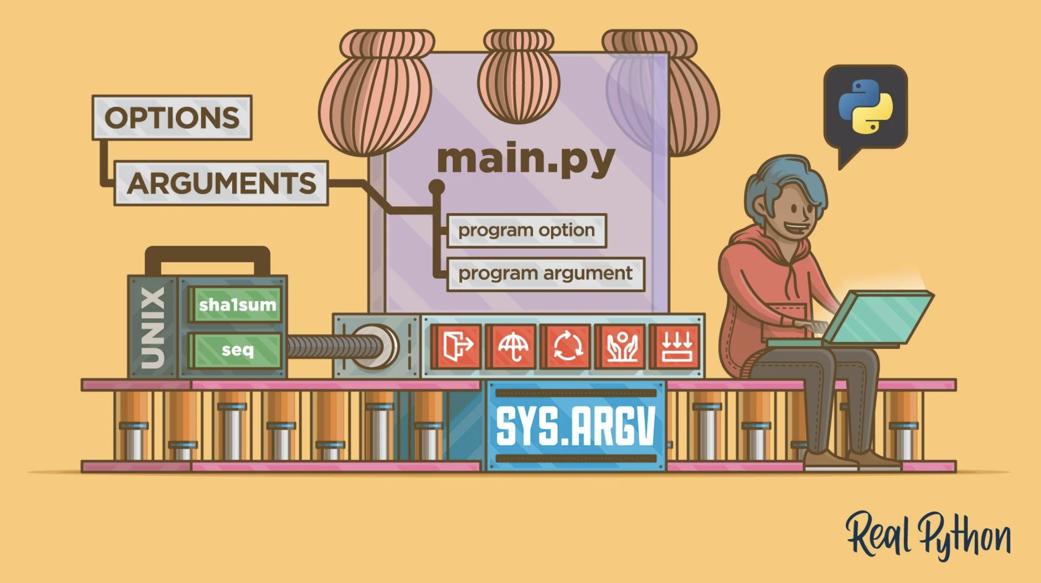
Command Line Arguments

Slide 28
Command Line Arguments – Examples
Lead with R examples, move to Python/typer
Discussion – Any examples of when you use or would like to use command line arguments?
Run files on another year
Different input parameters, random seeds, bootstrap with 1,000 or 10,000 etc.
Change model specifications, or graphs and titles

Slide 29
Linux Commands (Bash) – more stable
Ask Linux for the date instead of Python/R/Stata
Does a file exist, when was the last time it was touched.
Random sleep, wget concatenate.

Slide 30
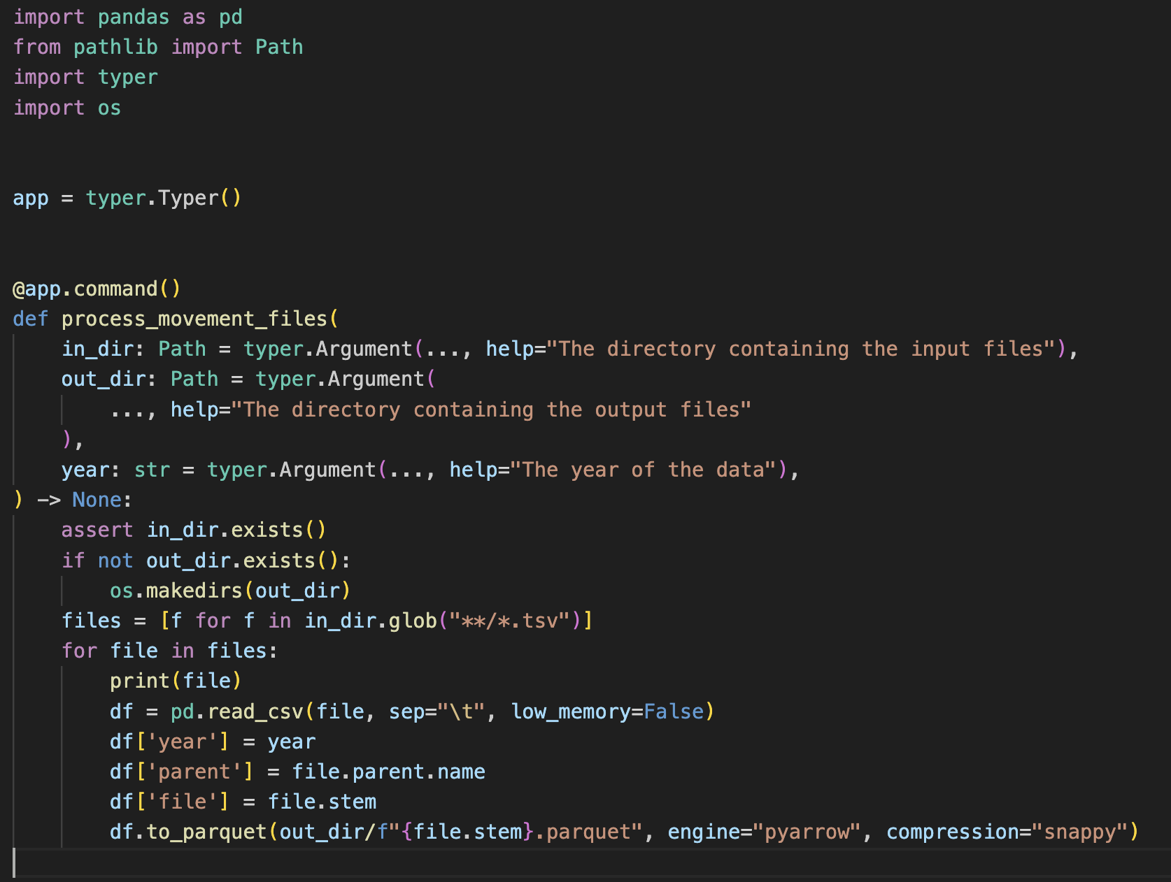
Example: Command Line Interface (CLI)

Slide 31
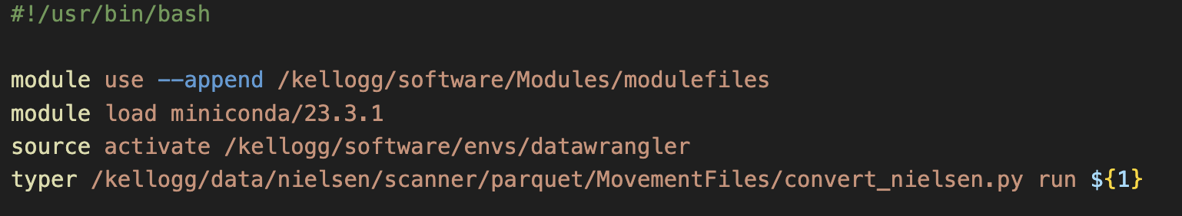

Turn into a Script

Slide 32
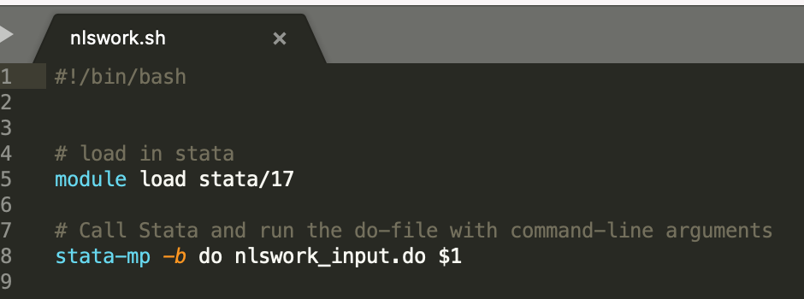
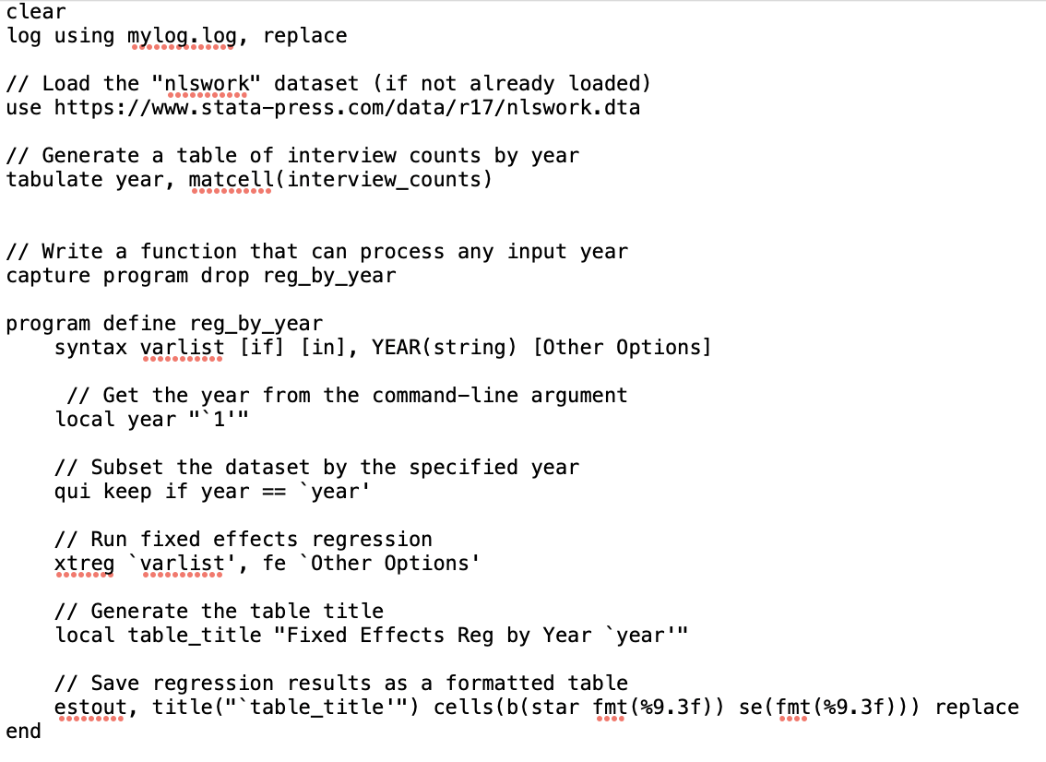
Example: CLI for Stata
nlswork_input.do

